Slide 1




Lift & Shift to Kafka Cloud
Confluent Professional Services Plan
15. May 2025
Bahar Sandal
Enterprise Account Executive
+41 79 326 57 08
bsandal@confluent.io
Wolfgang Panzer
Professional Services Practice Director CEMEA
+49 152 52 736 498
wpanzer@confluent.io
Niklas Kraßmann
Professional Services Practice Manager CEMEA
+49 176 80 566 536
nkrassmann@confluent.io

Slide 2
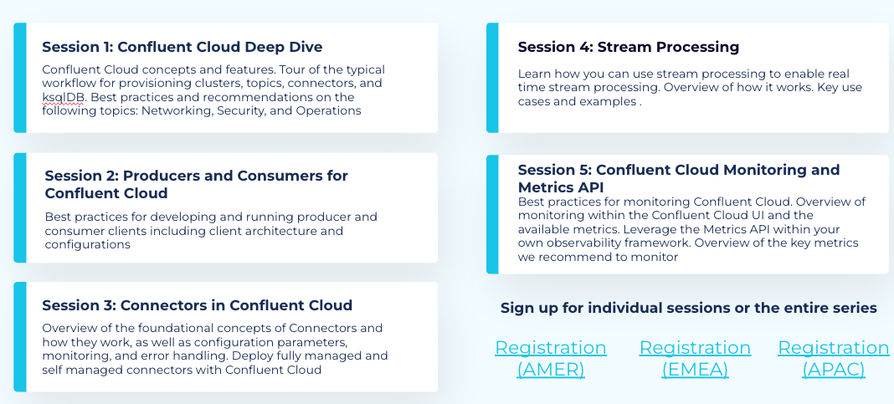
Preparing for the future
FREE (public)
Phase 1: Cloud Migration Readiness
Analysis & Discovery (Dependencies)
Preparation, Prerequisites & Enablement
Phase 2: Migration to CC
Migration Path and Strategy
Best Practices and Acceleration
Post-Migration Validation
2. Thematic Workshop
(Customer Specific)
Available on demand agreed with Account team if one subject/feature would be very interesting across the Org
Phase 3: Expansion & Optimization
&
Maximizing Investment
Besides technical migration challenges to be addressed by Professional services, we have other initiatives
3. Other free resources recap

Slide 3







Vaudoise Engagement Model
Lift & Shift to Kafka Cloud: Migration Assurance Services
Analysis & Discovery
Preparation
Data Migration
Workload Migration
Post-Migration Validation
Migration Assessment & Planning
E.g. Architecture Review, Roadmap, Risk & Migration Planning, …
Migration Execution
E.g. Data/Schema/Application Migration & Hands-On Support
Stabilization & Post-Migration Health Review
E.g. Post-Migration Go-Live Support, Health Check, Post-Migration Checklist
Accelerating Your Value Realization: Business Value Services
A Future Beyond the Migration
Business Value Planning
Regular Reviews, PS Roadmap, Pipeline Planning
Event Storming
Use-Case Discovery, Event Mapping, Idealization
New Use Case Onboarding
E.g. Event Hub vs. Managed Kafka?
Cost/Architecture/Compliance Review
Cost Tuning, Security & DR Drills, Health Checks
Support Escalation & Case Review
Case Management & Pro-Active Escalations
Executive Alignment
Customer Success
Your Path to Self-Sufficiency: Continuous Enablement Services
Enterprise Enablement
Foundational Training
Onboarding Plan
Thematic / Best-Practices Workshops
Expert Office Hours
Lessons Learned
Innovation Sprints/Hackathons
Kafka Summit
Product Release Enablement
Learn Meetups & Events
Product Management Engagement

Slide 4
Vaudoise Engagement Packages
# | Package | Typical Activity Examples | Resident Solutions Architect (RSA) | Resident Field Engineer (RSE) | Engagement Manager (EM)
1 | Migration Assessment & Planning | Architecture Review, Roadmap, Risk & Migration planning | 60h | 60h | 12h
2 | Migration Execution (±6 months**) | Data/Achema/Application Migration, Cutover, Support | 90h | 160h | 16h
3 | Business Reviews & Planning | Quarterly/BI-annual reviews, PS Roadmap, Pipeline planning | 48h | 16h | 24h
4 | Architecture Reviews & Health Checks | Periodic best-practice checks, remediation | 80h | 80h | 4h
5 | Event Storming Workshops | Use case discovery, event mapping, ideation | 40h | 24h | 8h
6 | Implementation of New Use Cases | Solution design/dev, PoCs, integration | 140h | 220h | 24h
7 | Enablement & Training | Onboarding, platforms, best-practice workshops | 32h | 32h | 4h
8 | Cost/Optimization/Compliance Reviews | Cost tuning, security, DR drills, … | 36h | 48h | 8h
9 | Innovation Sprints/Hackathons | Prototyping, innovation workshops | 34h | 24h | 8h
10 | Support Escalation & Case Review | Case management, proactive escalations | 16h | 16h | 4h
Totals |  |  | 576 Hours | 704 Hours | 112* Hours
Additional Notes & Limitations
Year 1: “Migration & Enablement Focus” / Year 2-5: “Business & Architecture Reviews”, “Event Storming”, “New Use Cases”, “Optimization”, “Innovation Sprints”
The package, role, and year splits are indicative—real-world demand, scope changes, or unforeseen challenges may require hour adjustments.
*16 hours of EM time is reserved for contingency/flex needs.
**±6 months average migration time and depending on many factors and can be verified after Assessment and Planning
No detailed per-activity event frequency or hour-by-hour splits are available; annual distributions should be rebalanced based on customer demand and project load.

Slide 5
Migration Assurance Services Summary
Analysis & Discovery
Preparation
Data Migration
Workload Migration
Post-Migration Validation
Review platform health, uplift existing operation runbook
Existing Usage Review, Migration plan preparation
Prepare & provision managed service
Configure Migration Monitoring
Application Migration
Platform
Configure Data Migration Solution (CL or Replicator)
Review application health, determine post-migration to-do list
Review & prepare applications for migration
Applications

Slide 6
Migration Assurance Services
A Data In Motion Blueprint Offering

Slide 7



Migrations are not primarily about clusters
Teams
Applications
Data
A migration is a process involving multiple participating teams with their own timelines and commitments to the business.
Teams are responsible for operating multiple applications that likely have uptime requirements and internal state that must remain consistent across the move.
Data must continue to be accessible to the applications that need it throughout the migration process. This requires a fine level of choreography.

Slide 8
Organizational Enablement
Confluent Developer: Tutorials, Demos, Podcasts, Blogs, Videos
Developer Resources
Confluent YouTube Channel
Confluent Blog
Confluent Webinars
CC Documentation
CC Documentation
Supported Versions and Interoperability
Reactive Break/Fix Support
Support Portal Login
Subscribing to Updates and Announcements
Training - Level Up Your Skills
Formal Training
Customer Success Team
CSTA Office Hours
CSM Touch Points
Solutions & Use Case Hub
Streaming Applications
Solutions / Architecture Hub

Slide 9





Migration Overview
Migrate to Confluent Cloud involves moving the underlying Kafka Platform, Kafka client & Streaming Applications.
Depending on the situation, some Kafka Clients could transition into managed world and some Kafka Clients might remain as self-managed. One of the key decision is driven by whether private network is required or not.
Self-Managed
Managed
Kafka Clients & Streaming Apps
Connector
Schema
Schema
Connector
Apps (Producer/Consumer)
ksqlDB
ksqlDB
Repoint Self-Managed Applications to Confluent Cloud
Kafka Platform
Confluent Platform
Kafka Cloud (e.g. MSK)
Kafka
Confluent Cloud

Slide 10
Your migration journey
Analysis & Discovery
Preparation
Data Migration
Workload Migration
Post-Migration Validation

Slide 11


Determine your migration approach
Workload Transition only
(No Data Migration)
With Data Migration
Existing data will be retained in existing cluster until expired
Benefit
Suitable for simple solution
Cheaper migration cost
Saving on migration effort
Saving on data transfer cost
Existing data will be migrated into Confluent Cloud as part of migration
Benefit
Suitable for complex solution that require to historical data in the cloud or involves multi-phases processing
Retain and co-locate historical data in the same place to make

Slide 12
Determine your migration approach
When data migration is not required, the initiative will typically focus on transitioning the application(s) to leverage managed service directly.
Analysis & Discovery
Preparation
Data Migration
Workload Migration
Post-Migration Validation
With Data Migration
Without Data Migration

Slide 13




Analysis & Discovery
Inventory existing Kafka resources including Kafka Topics, components configurations, ACL, credential, Schema, Connectors, etc…
Identify and engage involved projects/teams to review existing application flows, configurations
Review existing workload patterns, identify peak and spike to determine optimal configuration as per migration need
Prepare Migration Plan

Slide 14



Preparation
Platform Preparation
Prepare Confluent Cloud Environment (Automation is recommended)
Establish essential platform monitoring to support daily management & operation need.
Prepare self-managed components to support use cases that requires to operate on private network connectivity.
Application Preparation
Prepared required network connectivity, certification change required by the applications
Review and optimise the solution toward “responsible consumption”, ranging from simple configuration optimisation to design/implementation optimisation to achieve the same with less.

Slide 15

Data Migration
Prepare & configure replication solution.
While Cluster Link (CL) is preferred, replicator can be considered when CL solution is not feasible.
Establish data migration monitoring solution and verify data migration status by determining replication lag

Slide 16




Workload Migration
Reconfigure Kafka clients.
For applications that have been operating on older versions of Kafka Client package (< 2.7), consider upgrading to a more recent Kafka client.
Progressively migrate and repoint applications to Confluent Cloud according to the designed migration order.
Thoroughly test the end-to-end solution to assure the functionality and performance remains within expectation.
Define and configure appropriate credentials and access rules to grant just enough access for the application.

Slide 17


Post-Migration Validation
Review the post-migration status, ensure solutions and platform remain operating at healthy state.
Review and revise existing runbook to reflect the change as part of the solution is a managed solution.
Define post migration follow up plan to ensure any resolved risks, issues are being captured and actions accordingly

Slide 18
Success with Confluent Professional Services
Trusted Partnership Throughout Your Entire Journey

Slide 19
It’s about a Partnership!
Accelerate time-to-value
Improve adoption and productivity
Reduce and mitigate risk
Our Customer Success team helps you with your project, your enablement and adoption and operational support crucial to your success
Project Focused Initiatives
Enterprise Alignment
Enterprise Enablement

Slide 20




Benefits of working with Confluent Professional Services
1
2
3
4
Experience
Quality & Confidence
Accountability
Scale
Most accomplished Kafka and Confluent Engineers and Strategists in the world
Prescription through fully supported experience based, best practices
Full alignment and partnership with Product Development and Leadership
Access to and coordination with an expansive, enabled services partner ecosystem
Accelerating Data in Motion capability and value realization
Notes:
SHOW DIFFERENT MODELS FOR HOW WE HELP OUR CLIENTS MIGRATE. LIGHTWEIGHT TO END-TO-END-SOLUTION

Slide 21
We are addressing
Evangelisation / The Value of Event streaming | Introducing event streaming and Confluent platform require a mind of change and a transition to a new way of working and understanding data operations
Skills and Experience | Continuous Enablement
Use Case Onboarding / Architecture | Showcase the need of sharing data across many different teams / Design with having the long term goal in mind
Security Aspects | Guide you to implement the right level of security with the right approach for your business
Deployment Strategy | Determine a strategy for system deployment and evaluate incurred costs and requirements
Monitoring Health | Plan a strategy and implementation of observability
Streaming Data Management strategy | Platform adoption can be empowered with realistic sub projects, so that using the streaming platform becomes the reality and not just an exotic dream
Complexity of the Project / Dev-Ops | The business context and the expected business value do both influence implementation details on many levels at any time

Slide 22
Professional Services Engagement Journey
We build and hand-over
Build together
We coach,
you build
We design and build
Based on Use Cases
We design and help build
We advise on design, and support your resources during the build
Cost effective with Confluent Partners, Long-term success
Skills and knowledge transfer
Best Practices Advisory
Better suited for experienced internal team
We lead all streams of DEV, SIT/UAT, Training & Documentation
You own the DEV, SIT, UAT, Training & Documentation
You own the build, DEV, SIT/UAT, Training & Documentation
Confluent Deployed Model
Collaborative Model
Enablement Model
20% Client / 80% Confluent
50% Client / 50% Confluent
80% Client / 20% Confluent
Self-Sufficiency
Notes:
SHOW DIFFERENT MODELS FOR HOW WE HELP OUR CLIENTS MIGRATE. LIGHTWEIGHT TO END-TO-END-SOLUTION

Slide 23
What does the Project Team contribute
Solution Architect
Solution Architect: Senior resource with expertise across Development and Operations, helping outline the platform and application architecture and validate adherence to the agreed upon architecture and Confluent best practices according to defined project/roadmap objectives.
Sample Activities:
Architecture and Design, Infrastructure and Sizing, Security Setup, Topic and Partition Strategy, Disaster Recovery, General Data strategy, Technical Lead
Field Engineer: Provides hands-on enablement and assurance working directly with customer development and operations teams in order to accelerate customer delivery time and accelerate customer self sufficiency. May include activities such as coaching/guidance, paired programming, code review, configuration review, debugging, analysis, knowledge asset creation, knowledge transfer.
Sample Activities: Peer programming, code review, configuration review, debugging, analysis, knowledge asset creation, knowledge transfer.
Engagement Manager: The Engagement Manager will assist in defining and refining customer implementation roadmap, working with customer to unblock advisory and assurance activity impediments, contributes implementation and planning expertise to customer management
Sample Activities:
Coordination activities, Single Point of contact for all Delivery activities, Steering Board member (QBR), Accountable for Delivery Quality, Support Sales with Status meetings and report, etc.
Field Engineer
Engagement Manager

Slide 24
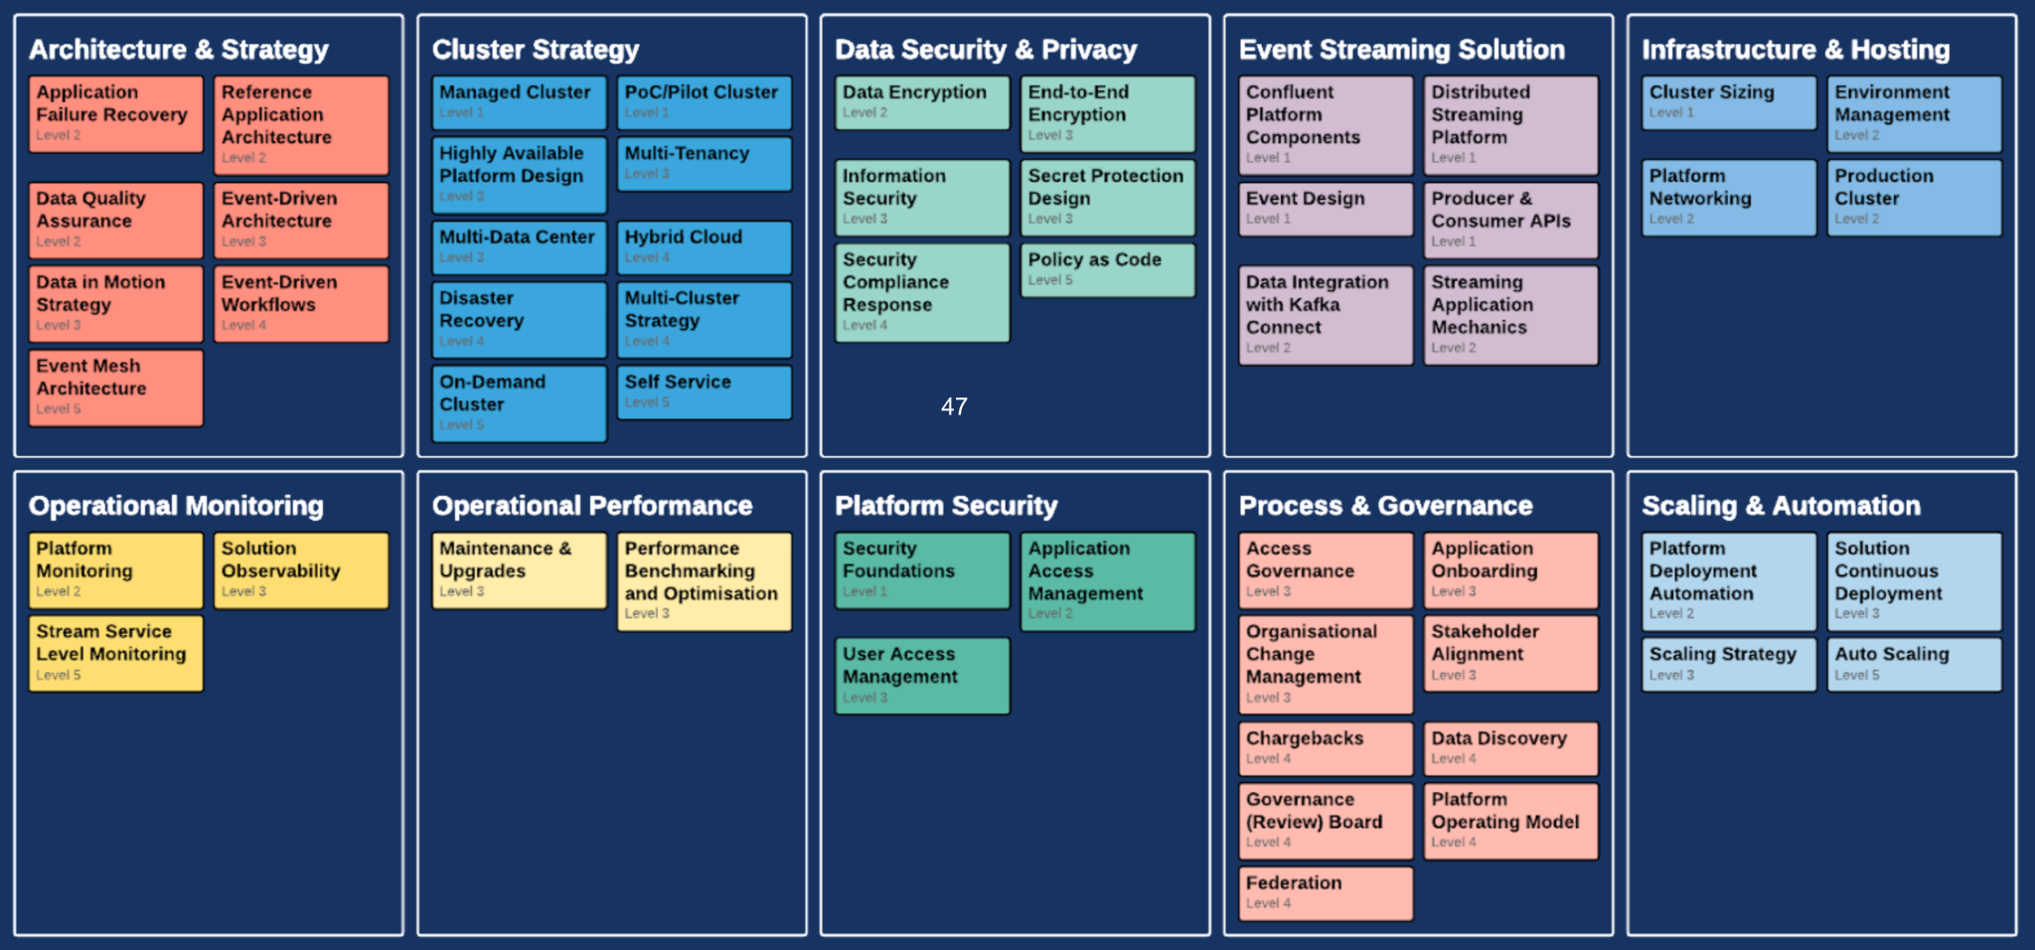
The Adoption Framework
Adoption Framework
The Adoption Framework is a collection of topics, organized by theme, that are necessary along the maturation & implementation of data in motion

Slide 25
Project Scheduling Guidelines
Engagement Type / Video Conferencing
Scheduling
Fully remote & Microsoft Teams (preferred) / Zoom
Resource shall be available on Teams during scheduled days and working hours.
Professional Services engagement days will be scheduled with the Practice/Engagement Manager and will be delivered as per the agreed schedule.
The lead time for resource scheduling is approximately 2 to 4 weeks, though efforts will be made to expedite this process when possible.
Please provide at least 10 business days' notice for cancellations of scheduled engagements; otherwise, the days may be subject to forfeit.
Work Hours
Standard working hours are between 9:00 AM and 6:00 PM CET, Monday to Friday (excluding public holidays) up to a maximum of forty (40) hours per week unless agreed un in advance.
Off Hour Service Delivery is subject to special scheduling and rate increases.
Online / Offline Work
Documentation
Engagements are booked for full 8 hours days but the expectation is that not all 8 hours will be interactive.
E.g 4 hour workshops with the remaining balance of the day used solely for offline engagement activities such environment preparation, reviews, documentation and researching recommendations based on scope of engagement
Daily summaries will be sent out by the Solutions Architect or Consulting Engineer either at the end of each day or first thing the following morning.
Technical documentation will be uploaded to the customer’s SharePoint or online documentation systems as needed.

Slide 26
Education
Training & Certification

Slide 27


Education Drives Understanding and Adoption
Formal training is the foundation for building your team’s Apache Kafka® knowledge and expertise in the field of data streaming. As technology evolves and becomes more complex, education is critical in:
Accelerating Development Time
Improving Efficiency
By training project members with practical, hands-on experience
Improving efficiency of applications through expanded usage and adoption

Slide 28




When aligned to the right environment
On-Prem or Hybrid Customers
Confluent Cloud Customers
Apache Kafka® Administration by Confluent
Confluent Developer Skills for Building Apache Kafka®
Confluent Advanced Skills for Optimizing Apache Kafka®
Confluent Stream Processing Using ksqlDB & Apache Kafka® Streams
Learn more at confluent.io/training/
Notes:
Formal training is the foundation for building your team’s Kafka knowledge and expertise
Additionally, taking the initial formal training in advance of a Professional Services Engagement allows for a higher value consulting experience as your team can focus their questions to your specific environment and concerns

Slide 29
Delivered based on employees’ needs and skill sets
Level 0 Intro*
Confluent Fundamentals for Apache Kafka® | Learn about Apache Kafka® and the Confluent platform, including an overview of Kafka’s core concepts.
Administrator Track Courses |  | Developer Track Courses
Level 1 Courses
Apache Kafka® Administration by Confluent | Learn to build and manage Kafka clusters using industry best practices developed by the world’s foremost Kafka experts. | Confluent Developer Skills for Building Apache Kafka® | Learn how to build an application that can publish data to, and subscribe to data from, a Kafka cluster.
Level 2 Courses
Confluent Advanced Skills for Optimizing Apache Kafka® | Learn how to monitor, troubleshoot, and tune a real-time event streaming platform built with Kafka. | Confluent Stream Processing Using ksqlDB & Apache Kafka® Streams | Learn how to use Confluent ksqlDB to transform, enrich, filter, and aggregate streams of real-time data using a SQL-like language.
*Confluent Fundamentals for Apache Kafka® is a prerequisite for both Level 1 Courses, Confluent Stream Processing using ksqlDB and Apache Kafka® Streams, and many Professional Services engagements
Notes:
Confluent learning paths help guide your team on the recommended courses based on your role
While everyone starts off with the same foundation these learning paths illustrate the journey to become expert in the functions of Kafka you need to perform your job duties

Slide 30
And in a manner best suited to your organization
Free Self Paced | Digital Self-paced training to allow customers to train at their own pace. See website for current courses
Private | Live training with delivery tailored to customer’s business needs. Ideal for training a large number of employees at once (minimum class: 10, maximum: 15)
Public | Train live alongside your community peers. Ideal for customers with smaller numbers of users to be trained at a time. See website for availability
.
Notes:
We understand that different customers and groups have different training preferences so we have a wide variety of delivery methods for you to choose from
We always recommend one of the live instructor options, so that your team has the ability to interact and ask questions to the instructor; however if your schedule doesn't permit if there are self paced options.

Slide 31
Education Offering Snapshot
Instructor - Led Training
Confluent Certification
Free Self Paced Training
Remote Private 3 Day Training (Up to 10 Students)
$16,000 *
Private 3 Day Training - Additional Student
$1,600 *
Public 3 Day Training - Single Student
$2,000 (Credit Card Only)
Confluent Certifications available for both Developer and Administrator
$150 (Credit Card Only)
Access to our self-paced content organized into learning paths aligned to a role or technology
*US List Pricing, Onsite pricing available for additional fees

Slide 32




Self Paced Training: Curriculum
Learning Paths Available:
Developer
Administrator
Confluent Cloud
Security
Installing Confluent Platform
Kafka Fundamentals
Build Event Streaming Pipeline
CP Implementation Design Decisions
Stream Processing
Create Event Streaming App with ksqlDB using CP
Write Source Connectors
Certification Bootcamp for Developers
Client Authentication
Encrypt Data in Motion
Install CP
Common Admin Commands/Tasks
Kafka Fundamentals
Manage Kafka topics
CP Implementation Design Decisions
Encrypt Config with Confluent Secret Protection
Config Broker Listeners
Encrypt DIM with SSL/TLS
Authentication: LDAP
Implement Mutual TLS
Manage Access RBAC
Automate Deployment with Ansible / Kubernetes
Scale Clusters
Deploy Schema Registry
Ensure QoS
Tuning Brokers & Clients
Deploy Brokers
Scale CP Clusters
Event Driven Design
Intro to Confluent Cloud
Create an Event Streaming App with ksqlDB
Confluent Cloud Security
Intro to Secure CP
Intro to Secure CC
Secure Schema Registry
Secrets Management
Manage access with RBAC
Authentication: LDAP
Authentication: Kerberos
*As of 06.09.2022. See website for current courses

Slide 33




As demand for Apache Kafka® grows, distinguish yourself with a Certification
Accreditation is your stepping stone to the advanced Confluent Certifications.
Learn more at Confluent.io/Certification
Confluent Fundamentals
Accreditation
- Designed to validate professionals’ basic knowledge of event streaming & jumpstart your Confluent learning journey
- Unproctored
- 23 Multiple Choice Questions
- FREE!
Confluent Certification
- Designed to validate professionals with a minimum of 6 months of Confluent experience. Additional benefits including exclusive invites & appreciation events
- Remotely Unproctored
- 40 to 60 Multiple Choice Questions
- Free Study Resources
Passed the exam?
Brag a little by sharing your digital badge!

Slide 34
Thank You

